Slide 1
Teaching and Learning Models
Asoc. prof, dr. paed. Indra Odiņa
A 302 phone 29528472
E-mail: indra.odina@lu.lv
Mailbox: A 306

Slide 2
Teaching and Learning Models
CLIL,
Cooperative Learning,
discussion, debate,
role play, simulation,
concept formation,
concept attainment

Slide 3
Teaching and Learning Models
journal entries,
Individual assignments,
team teaching:
planning mini-lesson and presentation,
teaching
reflection

Slide 4
Cooperative learning?

Slide 5
Group?
“group work”?
3 – 6 individuals work together

Slide 6
MAX :
3 things you like about group work Motivation
V
V
V
2 things you consider significant to make group work effective Acquisition
V
V
1 thing that bothers you about group work Extension
V

Slide 7
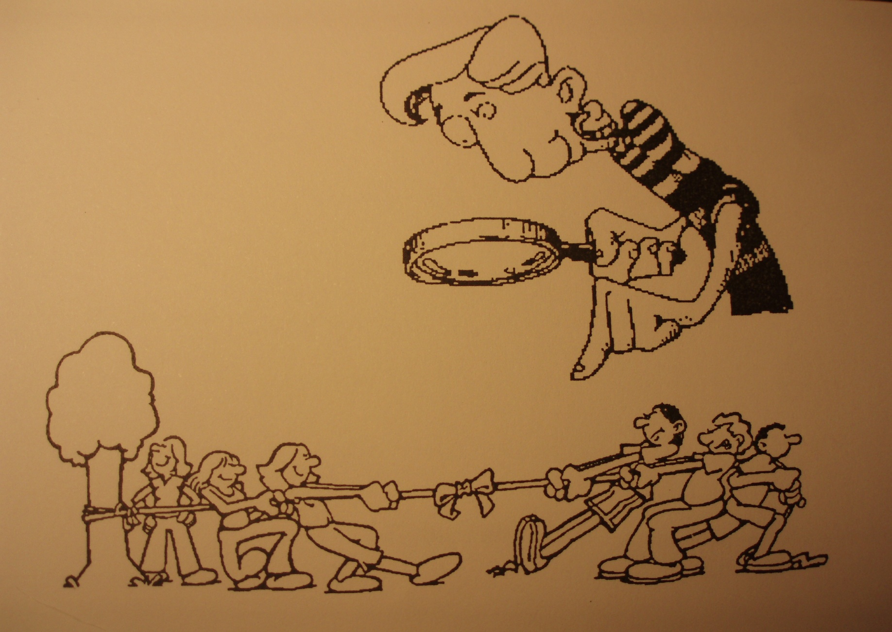
How long have you «worked» at SCHOOL?

Slide 8
Tokens for talking
The smallest experience comes to fetch tokens
One token of each colour for each participant
Red to ask question
Blue to contribute
Orange to add
Signal with a token if you want to contribute
Put the token in the middle of the table and start speaking

Slide 9
How did we do?
First used tokens
Last used token

Slide 10
Use student selector to choose ROLES:
QUESTION ASKER is the person who has rights to turn to the workshop organiser with the question if there is something you cannot find out the answer in your group.
TIME KEEPER is the person with the watch/phone and who follows the time and instructions.
MODERATOR leads the group work.
NOTE KEEPER carries out all the written tasks of the group.
PRESENTER does all kinds of presentations.

Slide 11
What difficulties have you faced working in groups or using group work yourselves?

Slide 12
Working in group 5 minutes
☹

Slide 13
BUTTONS in groups
Count your buttons individually
Count together group buttons
One difficulty with group work from each group at a time
Listen carefully, don’t repeat the same ideas
Voting for the most difficult thing

Slide 14
Difficulties working in groups or using group work
Noise
Discipline problems
Group formation
Assigning to groups
Time consuming
Inequal participation
Assessment

Slide 15
Cooperative learning?

Slide 16
5 basic elements of cooperative learning
1. Positive interdependence
2. Individual accountability
3. Face-to-face interaction
4. Social skills
5. Processing

Slide 17
5 CL elements
1. Positive interdependence:
GOAL
INCENTIVE/REWARDS
Roles change:
Evaluate incentives

Slide 18
5 CL elements
1. Positive interdependence:
GOAL
INCENTIVE/REWARDS
RESOURCE
ROLES
SEQUENCE/TASKS
SIMULATION
OUTSIDE FORCE
ENVIRONMENTAL
IDENTITY/GROUP SPIRIT
GROUP PRODUCT

Slide 19
Roles change:
Test your thinking

Slide 20
5 elements of cooperative learning
2. Individual accountability:
Roles change:
WHAT WOULD YOU TRY OUT?
SIGNATURES
SAMPLING
QUIZZES
CHECKPOINTS
COLORED PENS
3. Face-to-face interaction

Slide 21
5 elements of cooperative learning
4. Social skills
SPEAKING ON THE MICROPHONE
HOW WOULD YOU DEFINE WHAT SOCIAL SKILLS ARE?
KEEP PASSING THE MICROPHONE AROUND
A SHORT SUMMARY

Slide 22
Social skills
Social - the interaction of people
Skills – the appropriate verbal and nonverbal means of communication
Can you mention any?
Round table

Slide 23
5 elements of cooperative learning
4. Social skills
A complicated set of several skills that cater for successful communication with people
Basic group skills
Functioning skills
Higher-order thinking skills
Sorting out the skills (home assignment)

Slide 24
To develop social skills means
Helping students understand:
1) WHY the skill is needed
2) WHAT it means – e.g. Sharing skills
It looks like | It sounds like
Showing your material | Here you are

Slide 25
Squares
Group receives materials, puts them in the middle of the table
One is observer (takes observation task)
One reads the rules in groups, if they are clear, all sign them that they know them and agree to act accordingly
Now each group member takes the envelope, opens it and takes out the pieces
Remember – we do it in silence: Let’s start!!!
What was your group’s success?
Observers tell about their observations.

Slide 26
5 elements of cooperative learning
5. Processing:
ACADEMIC FEEDBACK
SOCIAL SKILL PROCESSING:
SELF-EVALUATION
OBSERVER EVALUATION
GROUP EVALUATION
TEACHER EVALUATION

Slide 27
Individual processing
Processing
1. How much did you participate in a group work?
Rate yourself:
1 2 3 4 5 6 7 8 9 10
Weak Devoted
participation participation
2. Share your self-rating with your partners. Explain why you rated yourself as you did, and what you would do next time to improve your participation.

Slide 28
Participation pie
How would you share this pie among you according to your contribution in today’s work?

Slide 29
Grounded
Social interdependence theory
Gestalt School of Psychology (K. Koffka)
Modern day social psychology (K. Lewin) beginning of 20th century
J. Piaget’s cognitive development principles
Behavioural learning theory
70 – 80

Slide 30
Grounded (home assignment)
Elliot Aronson
David and Roger Johnsons
Spencer Kagan
Shlomo Sharan and Yael Sharan
Elizabeth Cohen
In Latvia 90th LAPSA/ LACE
67 benefits: (T. Panitz)

Slide 31
Numbered heads together Today we had
Activity - Why? – how it could be used?
MAX
Tokens for talking
Inside – outside circle
Roles
Group identity
Button counting

Slide 32
Numbered heads together Today we had
Activity - Why? – how it could be used?
Individual processing
Participation pie
Speaking on the microphone/ Say and Switch
Round table
Squares
Numbered heads together
Send a problem

Slide 33
Home assignment
Quiz on Cooperative Learning

