Slide 1
DIMTEGU – Development and Introduction of Multilingual Teacher Education Programs at Universities of Georgia and Ukraine
February 18th-20th 2013, Dnipropetrovsk, Ukraine

Slide 2
Ligita Grigule:
Socrates once said "I cannot teach anybody anything, I can only make them think".
Indra Odina: I believe in
learning by doing

Slide 4
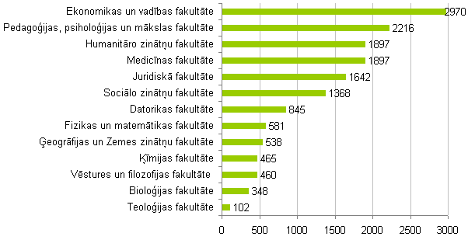
Students

Slide 5
403 are foreign nationals from 56 countries
Of the 403 (235 men and 168 women) foreign students:
234 degree or qualification studies in Bachelor, Master, Doctoral or Residency study programmes
169 – visiting students
Germany (87 students), Spain (29 students) and Italy (26 students), more than 10 students – Lithuania, Estonia, Sweden, Norway, Poland, Russia, Montenegro and France.
1 student : Albania, Australia, Azerbaijan, Bangladesh, Bosnia and Herzegovina, Brazil, the Democratic People's Republic of Korea, Mauritius, Moldova, Nigeria, Slovakia, Hungary and Kosovo.

Slide 6
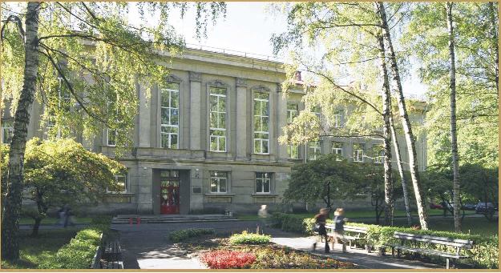
Faculty of Education, Psychology and Art
2nd largest – a leading institution in
pedagogy, psychology, teacher education and
education management.

Slide 7
Faculty of Education, Psychology and Art
34 full-time and part-time study programs for 2400 students in integrated professional bachelor (4 years), master (2 years) and doctoral programs (3 years).
4 departments:
Pedagogy,
Psychology,
Education Management and
Teacher Education Department
2 centres: Sports Centre and Adult Pedagogical Education Centre and
Scientific Pedagogical Institute and Institute for Educational Research.

Slide 8
Faculty of Education, Psychology and Art Teacher Education Department
study program “Teacher”
future teachers in 11 subjects and 16 modules (for teacher qualification in 2 different subjects)
in-service-teacher education in 20 school subjects
professional master program “Teacher”.
national wide mentor education system (in 2 years educated and qualified 1135 school based mentors)

Slide 9
Ligita Grigule, Mg. paed. ligita.grigule@lu.lv
In-service Teacher Education Coordinator
L2 Methodology
Cooperative learning
Mentoring
Bilingual education
Intercultural Education
Consultant on Multilingual Education at OSCE/HCNM

Slide 10
Dr. paed. asoc. prof. Indra Odina indra.odina@lu.lv
Head of Teacher Education Department
Interactive learning and teaching methods (cooperative learning)
Qualitative Research methods
ESP Methodology
Mentor and Mentor Trainer Professional Development
Moderator of British Council online courses
Inservice trainer of the Ministry of Education and Science
12th International Students’ Research Conference (ISRC) May 14 – 16
4th International Week for Professors (IWP) May 13 – 17

Slide 11
Latvian Association for Cooperation in Education
LACE

Slide 12
Методы обучения становятся методами учения
Approaches to classification of tools for teaching and learning. Выбор методов учения
Facilitating acquisition of subject terminology.

Slide 13
Models of Learning: Дидактические подходы
Личностные
Четыре семейства или общности:
Личностные – The personal family of models
Когнитивные (связанные с обработкой информации) – The information processing family of models
Социальные – The social family of models
Бихевиоральные – The behavioral systems family of models

Slide 14
DIMTEGU – Development and Introduction of Multilingual Teacher Education Programs at Universities of Georgia and Ukraine
February 18th-20th 2013, Dnipropetrovsk, Ukraine

