Slide 1
Inside – outside circle
Story of your name
Your career way
Preferred number of students in the classroom when teaching or learning
Biggest professional achievement
The best way to become university teacher
Free topic

Slide 2
Structuring Interviews and Discussions
V Session
Assoc.prof. Dr.Indra Odina, Ligita Grigule
Faculty of Education, Psychology and Arts, University of Latvia

Slide 3
The social family of models

Slide 4
Social Family Models
working together, classroom management is a matter of developing cooperative relationships in the classroom
include
Partners in Learning, Group Investigation, Role Playing, Jurisprudential Inquiry, Cooperative Learning

Slide 5
Inside – outside circle
Story of your name
Your career way
Preferred number of students in the classroom when teaching or learning
Biggest professional achievement
The best way to become university teacher
Free topic
So what???

Slide 6
In pairs A and B
The one whose
birthday is closer (A)
starts speaking
(1 min)
2. B in 30 sec
tells it back beginning:
I liked what you said
because ...

Slide 7
In pairs A and B
3. Now B is speaking
(1 min)
4. A in 30 sec
tells it back beginning:
The most interesting
thing in what you
said was...

Slide 8
In pairs A and B X 2
5. A and A tells about Bs
(30 sec and 30 sec)
6. B and B tells about As
(30 sec and 30 sec)
7. So what???

Slide 9
Group?
“group work”?
3 – 6 individuals work together

Slide 10
MAX :
3 things I like about group work Motivation
V
V
V
2 things I consider significant to make group work effective Acquisition
V
V
1 thing that bothers me about group work Extension
V

Slide 11
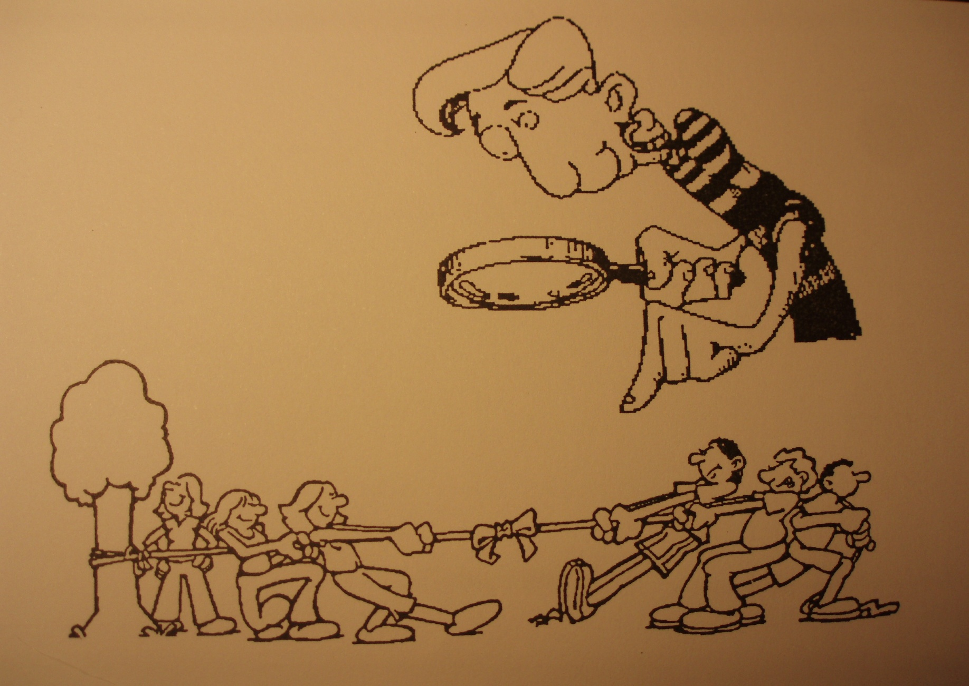
How long have you worked at UNIVERSITY?

Slide 12
Tokens for talking
The smallest experience comes to fetch tokens
One token of each colour for each participant
Orange to ask question
Pink to contribute
Yellow to add
Signal with a token if you want to contribute
Put the token in the middle of the table and start speaking

Slide 13
How did we do?
First used tokens
Last used token
So WHAT???

Slide 14
MAX :
3 things I remember about today Motivation
V
V
V
2 things I will take away Acquisition
V
V
1 suggestion I would make Extension
V

